Slide 1


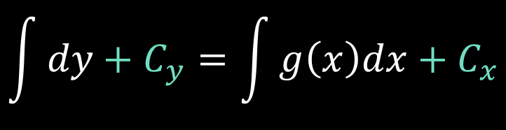





$$a_{n}\left(x\right)\left(\frac{d^{n}y}{dx^{n}}\right)+a_{n−1}\left(x\right)\left(\frac{d^{n−1}y}{dx^{n−1}}\right)+…+a_{1}\left(x\right)\left(\frac{dy}{dx}\right)+a_{0}\left(x\right)y=g(x)$$
$$\frac{dy}{dx}=g(x)$$
$$dy = g\left(x\right)dx$$
$$\int{dy}+C_{y}=\int{g\left(x\right)dx}+C_{x}$$
$$y=G\left(x\right)+C$$
$$y=\int{g\left(x\right)dx}+C$$

Slide 2

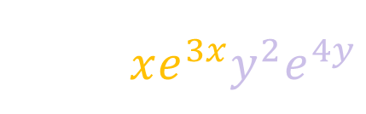
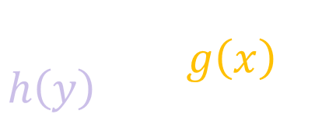






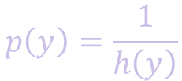


$$\frac{dy}{dx}=g(x)$$
$$h(y)$$
$$\frac{dy}{dx}=xe^{3x}y^{2}e^{4y}$$
$$\frac{dy}{dx}=y^{2}xe^{3x+4y}$$
$$\frac{dy}{h\left(y\right)} = g\left(x\right)dx$$
$$p\left(y\right)=\frac{1}{h\left(y\right)}$$
$$y=G\left(x\right)+C$$
$$p\left(y\right)dy = g\left(x\right)dx$$
$$P\left(y\right)=G\left(x\right)+C$$
$$P\left(y\right)+C_{y}=G\left(x\right)+C_{x}$$

Slide 3



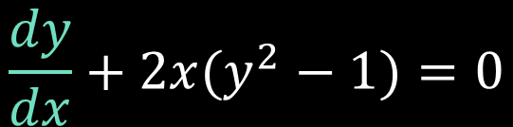
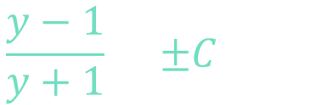
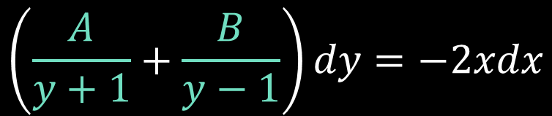



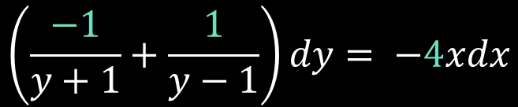

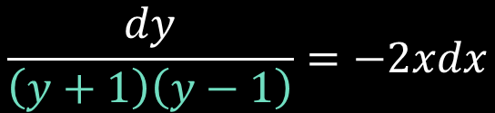



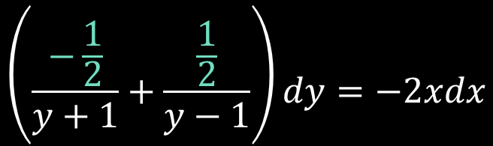



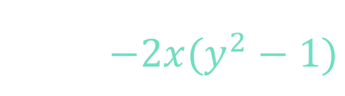



Example 1
$$\left(\frac{A}{y+1}+\frac{B}{y−1}\right)dy=−2xdx$$
$$y^{′}+2x(y^{2}−1)=0$$
$$A\left(y−1\right)+B\left(y+1\right)=1$$
$$\frac{dy}{dx}+2x(y^{2}−1)=0$$
$$\left(\frac{−\frac{1}{2}}{y+1}+\frac{\frac{1}{2}}{y−1}\right)dy=−2xdx$$
$$y=1:$$
$$B=\frac{1}{2}$$
$$2B=1$$
$$\frac{dy}{dx}=−2x(y^{2}−1)$$
$$\left(\frac{−1}{y+1}+\frac{1}{y−1}\right)dy= −4xdx$$
$$y=0:$$
$$A=−\frac{1}{2}$$
$$B−A=1$$
$$\frac{dy}{y^{2}−1}=−2xdx$$
$$\frac{y−1}{y+1}=±Ce^{−2x^{2}}$$
$$\ln\left|y−1\right|−\ln\left|y+1\right|=−2x^{2}+C$$
$$\frac{dy}{\left(y+1\right)\left(y−1\right)}=−2xdx$$
$$\ln\left|\frac{y−1}{y+1}\right|= −2x^{2}+C$$
$$\frac{y−1}{y+1}=Ce^{−2x^{2}}$$
$$e$$
$$e^{( ) }$$

Slide 4











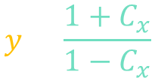
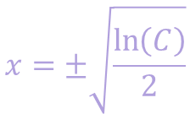
Example 1
$$y^{′}+2x(y^{2}−1)=0$$
$$\frac{y−1}{y+1}=Ce^{−2x^{2}}$$
$$y−1=\left(Ce^{−2x^{2}}\right)\left(y+1\right)$$
$$y−1=C_{x}\left(y+1\right)$$
$$y−1=C_{x}y+C_{x}$$
$$y−C_{x}y=C_{x}+1$$
$$y\left(1−C_{x}\right)=C_{x}+1$$
$$1−Ce^{−2x^{2}}=0$$
$$\ln\left(1\right)−\ln\left(C\right)=−2x^{2}$$
$$y=\frac{1+Ce^{−2x^{2}}}{1−Ce^{−2x^{2}}}$$
$$x=±\sqrt{\frac{\ln\left(C\right)}{2}}$$
$$y=\frac{1+C_{x}}{1−C_{x}}$$
$$\frac{1}{C}=e^{−2x^{2}}$$
$$−\ln\left(C\right)=−2x^{2}$$

Slide 5




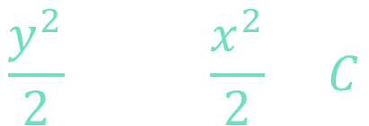









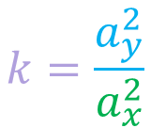

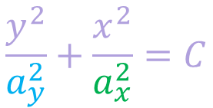

Example 2.a
$$\left(0,a_{y}\right)$$
$$\frac{dy}{dx}=−k\left(\frac{x}{y}\right)$$
$$\left(0,a_{y}\right)$$
$$ydy=−kxdx$$
$$\left(−a_{x},0\right)$$
$$\left(a_{x},0\right)$$
$$\left(−a_{x},0\right)$$
$$\left(a_{x},0\right)$$
$$ydy=−k xdx$$
$$\left(0,−a_{y}\right)$$
$$\frac{y^{2}}{2}=−k\frac{x^{2}}{2}+C$$
$$\left(0,−a_{y}\right)$$
$$\frac{y^{2}}{2}+k\frac{x^{2}}{2}=C$$
$$\frac{y^{2}}{a_{y}^{2}}+\frac{x^{2}}{a_{x}^{2}}=C$$
$$k=\frac{a_{y}^{2}}{a_{x}^{2}}$$
$$y^{2}+kx^{2}=C$$

Slide 6
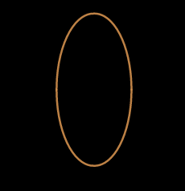
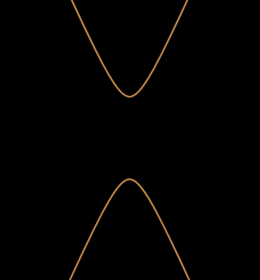
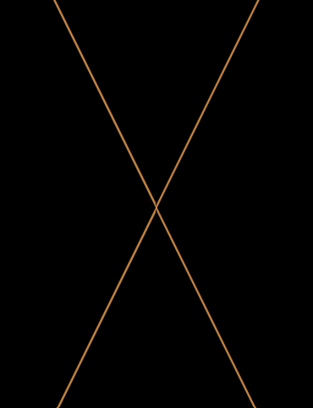
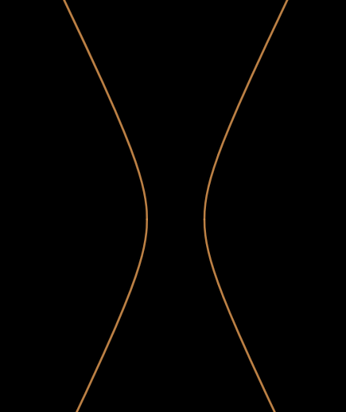
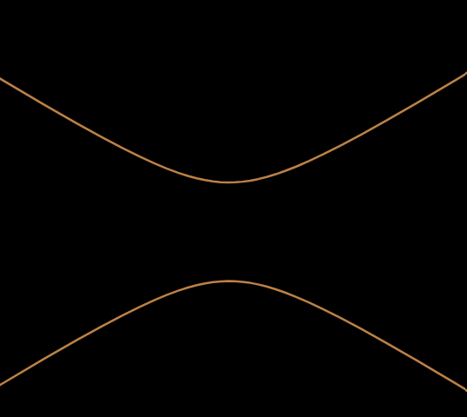
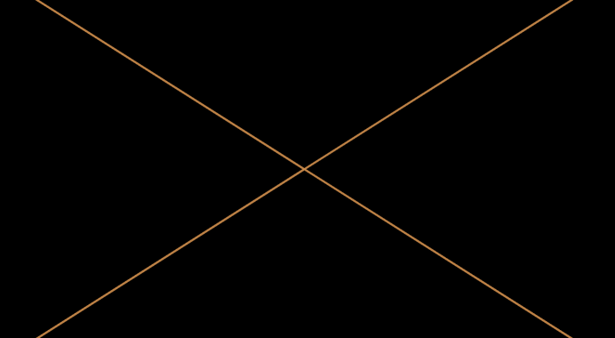
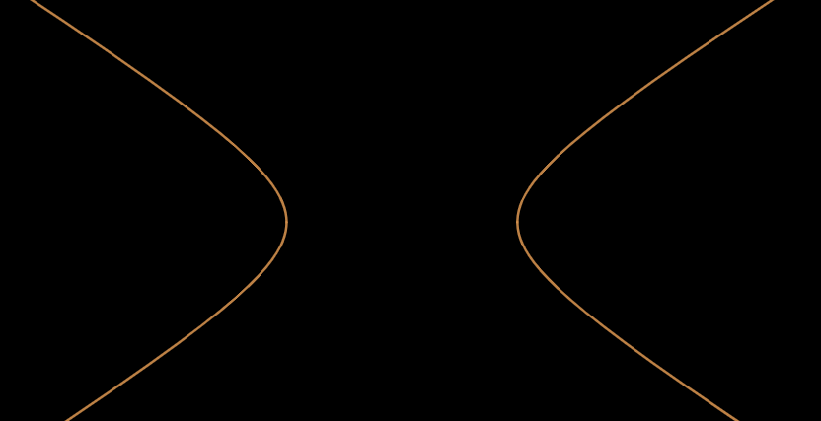
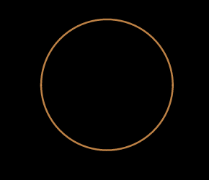
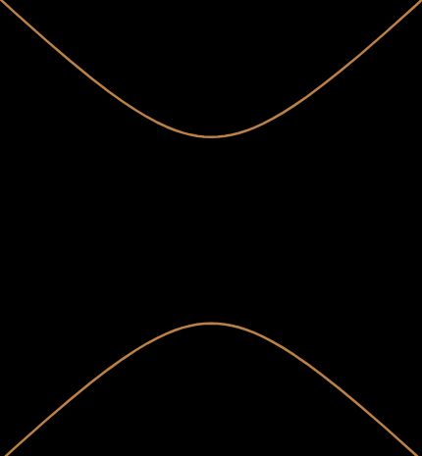
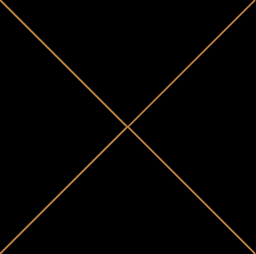
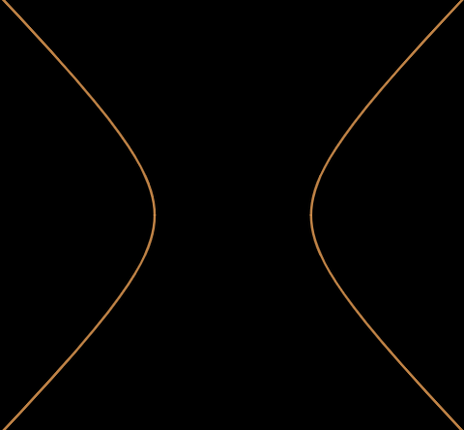










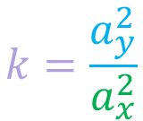








$$k<0$$
$$k>0$$
Example 2.a
Hyperbola (vertical)
Ellipse (vertical)
$$\frac{dy}{dx}=−k\left(\frac{x}{y}\right)$$
$$\left|k\right|>1:$$
$$C<0$$
$$C=0$$
$$C>0$$
$$C>0$$
$$\left|a_{y}\right|>\left|a_{x}\right|$$
$$y^{2}+kx^{2}=C$$
Hyperbola (horizontal)
Ellipse (horizontal)
$$|k|<1:$$
$$C<0$$
$$C=0$$
$$C>0$$
$$C>0$$
$$\frac{y^{2}}{a_{y}^{2}}+\frac{x^{2}}{a_{x}^{2}}=C$$
$$\left|a_{y}\right|<\left|a_{x}\right|$$
$$k=\frac{a_{y}^{2}}{a_{x}^{2}}$$
Hyperbola (equal)
Circle
$$C<0$$
$$C=0$$
$$C>0$$
$$C>0$$
$$\left|k\right|=1:$$
$$\left|a_{y}\right|=\left|a_{x}\right|$$
$$C≤0 →$$
vanishes

Slide 7











Example 2.b
$$\frac{dy}{dx}=−k\left(\frac{y}{x}\right)$$
$$\frac{dy}{y}=−k\left(\frac{dx}{x}\right)$$
$$\frac{dy}{y}=−k \left(\frac{dx}{x}\right)$$
$$\ln\left|y\right|=−k\ln{|x|}+C$$
$$e^{\ln\left|y\right|}=e^{−k\ln\left|x\right|+C}$$
$$y=Ce^{−k\ln\left|x\right|}$$
$$y=\frac{C}{{\left|x\right|}^{k}}$$
$$y={±e}^{−k\ln\left|x\right|}e^{C}$$
$$y=Ce^{\ln{{\left|x\right|}^{−k}}}$$

Slide 8
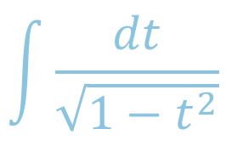
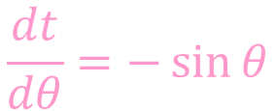

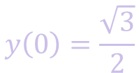

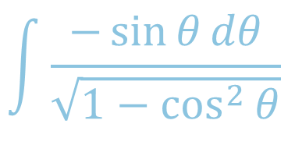


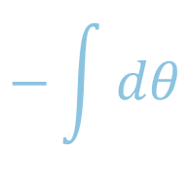


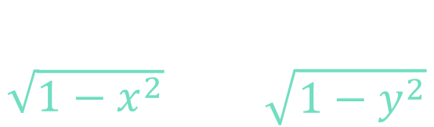
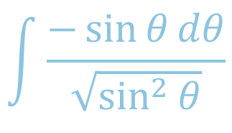




Example 3
(IVP)
$$\sqrt{1−y^{2}}dx−\sqrt{1−x^{2}}dy=0$$
$$y\left(0\right)=\frac{\sqrt{3}}{2}$$
$$\sin^{2}{θ}+\cos^{2}{θ}=1$$
$$\sin^{2}{θ}=1−\cos^{2}{θ}$$
$$\sqrt{1−y^{2}}dx=\sqrt{1−x^{2}}dy$$
$$t=\cos{θ}$$
$$\frac{dt}{dθ}=−\sin{θ}$$
$$\frac{dx}{\sqrt{1−x^{2}}}= \frac{dy}{\sqrt{1−y^{2}}}$$
$$dt=−\sin{θ}dθ$$
$$\int{\frac{dt}{\sqrt{1−t^{2}}}}$$
$$\int{\frac{−\sin{θ}dθ}{\sqrt{\sin^{2}{θ}}}}$$
$$−θ+C$$
$$\int{\frac{−\sin{θ}dθ}{\sqrt{1−\cos^{2}{θ}}}}$$
$$−\int{dθ}$$
$$−\cos^{−1}{t}+C$$

Slide 9



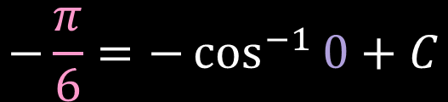





Example 3
(IVP)
$$\sqrt{1−y^{2}}dx−\sqrt{1−x^{2}}dy=0$$
$$y\left(0\right)=\frac{\sqrt{3}}{2}$$
$$\sqrt{1−y^{2}}dx=\sqrt{1−x^{2}}dy$$
$$60°$$
$$\frac{dx}{\sqrt{1−x^{2}}}= \frac{dy}{\sqrt{1−y^{2}}}$$
$$2$$
$$1$$
$$−\cos^{−1}{y}=−\cos^{−1}{x}+C$$
$$θ$$
$$30°$$
$$−\cos^{−1}{\frac{\sqrt{3}}{2}}=−\cos^{−1}{0}+C$$
$$\sqrt{3}$$
$$−\frac{π}{6}=−\cos^{−1}{0}+C$$

Slide 10


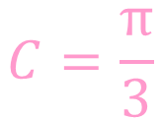
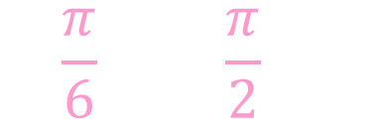


Example 3
(IVP)
$$\sqrt{1−y^{2}}dx−\sqrt{1−x^{2}}dy=0$$
$$y\left(0\right)=\frac{\sqrt{3}}{2}$$
$$0=\frac{x}{r}$$
$$x→0$$
$$θ→\frac{π}{2}$$
$$\sqrt{1−y^{2}}dx=\sqrt{1−x^{2}}dy$$
$$\frac{dx}{\sqrt{1−x^{2}}}= \frac{dy}{\sqrt{1−y^{2}}}$$
$$θ$$
$$−\cos^{−1}{y}=−\cos^{−1}{x}+C$$
$$−\cos^{−1}{\frac{\sqrt{3}}{2}}=−\cos^{−1}{0}+C$$
$$−\frac{π}{6}=−\cos^{−1}{0}+C$$
$$−\frac{π}{6}=−\frac{π}{2}+C$$
$$C=\frac{π}{3}$$

Slide 11
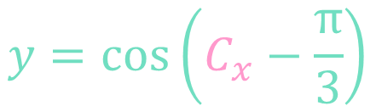




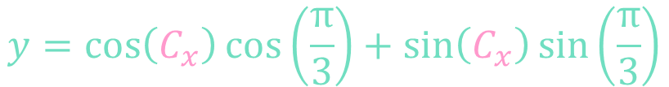


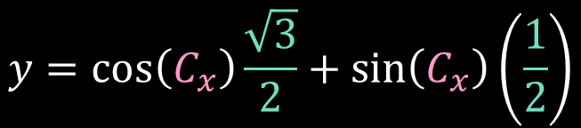
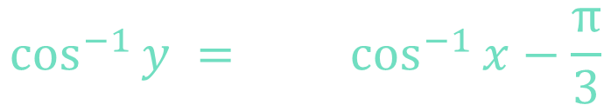

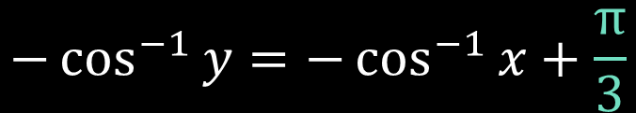


Example 3
(IVP)
$$\cos\left(a−b\right)=cos\left(a\right)cos\left(b\right)+sin\left(a\right)sin\left(b\right)$$
$$\sqrt{1−y^{2}}dx−\sqrt{1−x^{2}}dy=0$$
$$y\left(0\right)=\frac{\sqrt{3}}{2}$$
$$\sqrt{1−y^{2}}dx=\sqrt{1−x^{2}}dy$$
$$y=\cos\left(C_{x}−\frac{π}{3}\right)$$
$$C_{x}=\cos^{−1}\left(x\right)$$
$$30°$$
$$2$$
$$\frac{dx}{\sqrt{1−x^{2}}}= \frac{dy}{\sqrt{1−y^{2}}}$$
$$1$$
$$y=\cos\left(C_{x}\right)\cos\left(\frac{π}{3}\right)+\sin\left(C_{x}\right)\sin\left(\frac{π}{3}\right)$$
$$60°$$
$$θ$$
$$−\cos^{−1}{y}=−\cos^{−1}{x}+C$$
$$\sqrt{3}$$
$$y=\cos\left(C_{x}\right)\frac{\sqrt{3}}{2}+\sin\left(C_{x}\right)\left(\frac{1}{2}\right)$$
$$−\cos^{−1}{y}=−\cos^{−1}{x}+\frac{π}{3}$$
$$\cos^{−1}{y} = \cos^{−1}{x}−\frac{π}{3}$$
$$cos⁡( )$$
$$cos⁡( )$$

Slide 12











Example 3
(IVP)
$$\sqrt{1−y^{2}}dx−\sqrt{1−x^{2}}dy=0$$
$$y\left(0\right)=\frac{\sqrt{3}}{2}$$
$$x^{2}+y^{2}=r^{2}$$
$$x^{2}+y^{2}=1$$
$$\sqrt{1−y^{2}}dx=\sqrt{1−x^{2}}dy$$
$$y=\sqrt{1−x^{2}}$$
$$\frac{dx}{\sqrt{1−x^{2}}}= \frac{dy}{\sqrt{1−y^{2}}}$$
$$1$$
$$y$$
$$y=\cos\left(C_{x}\right)\frac{\sqrt{3}}{2}+\sin\left(C_{x}\right)\left(\frac{1}{2}\right)$$
$$θ$$
$$x$$
$$y=\cos\left(\cos^{−1}\left(x\right)\right)\frac{\sqrt{3}}{2}+\sin\left(\cos^{−1}\left(x\right)\right)\left(\frac{1}{2}\right)$$
$$\cos\left(θ\right)=x$$
$$\sin\left(θ\right)=\sqrt{1−x^{2}}$$

Slide 13
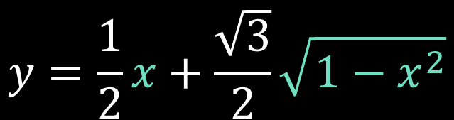
Example 3
(IVP)
$$\sqrt{1−y^{2}}dx−\sqrt{1−x^{2}}dy=0$$
$$y\left(0\right)=\frac{\sqrt{3}}{2}$$
$$\sqrt{1−y^{2}}dx=\sqrt{1−x^{2}}dy$$
$$\frac{dx}{\sqrt{1−x^{2}}}= \frac{dy}{\sqrt{1−y^{2}}}$$
$$y=\frac{1}{2}x+\frac{\sqrt{3}}{2}\sqrt{1−x^{2}}$$
$$y=\cos\left(C_{x}\right)\frac{\sqrt{3}}{2}+\sin\left(C_{x}\right)\left(\frac{1}{2}\right)$$
$$y=\cos\left(\cos^{−1}\left(x\right)\right)\frac{\sqrt{3}}{2}+\sin\left(\cos^{−1}\left(x\right)\right)\left(\frac{1}{2}\right)$$

